Slide 1

Inter Play of E-WAY BILL in GST
Presented by : CA. Ashis Agarwal
+91-75012 79772

Slide 2
Legal Framework
Section 68. Inspection of goods in movement.
Chapter : INSPECTION, SEARCH
68 (1) The Government may require the person in charge of a conveyance carrying any consignment of goods of value exceeding such amount as may be specified to carry with him such documents and such devices as may be prescribed.
(2) The details of documents required to be carried under sub-section (1) shall be validated in such manner as may be prescribed.
(3) Where any conveyance referred to in sub-section (1) is intercepted by the proper officer at any place, he may require the person in charge of the said conveyance to produce the documents prescribed under the said sub-section and devices for verification, and the said person shall be liable to produce the documents and devices and also allow the inspection of goods

Slide 3
Legal Framework
Section 129 Detention, seizure and release of goods and conveyances in transit.
Chapter : OFFENCES AND PENALTIES
129 (1) Notwithstanding anything contained in this Act, where any person transports any goods or stores any goods while they are in transit in contravention of the provisions of this Act or the rules made thereunder, all such goods and conveyance used as a means of transport for carrying the said goods and documents relating to such goods and conveyance shall be liable to detention or seizure and after detention or seizure, shall be released,- (subject to penalty)
Particulars | Owner comes forward to pay | Owner does not come forward
Taxable Goods | 200% of Tax Payable | Higher of 200% of Tax Payable or 50% of the value of goods or
Exempt Goods | Lower of 2 % of the value of Goods or Rs. 25,000 | Lower of 5 % of the value of Goods or Rs. 25,000
Goods can also be released upon furnishing of security equivalent to the amount as above

Slide 4

WHO CAN GENERATE E-WAY BILL
Mode of E-way Bill generation
Web-Online Based
Android-Mobile App
API-Site-to-Site integration
Bulk Generation
SMS-Through Mobile
Suvidha Provider-3rd party based
Registered Person
A registered Person Must generate E-way bill when there is a movement of goods of More than Rs. 50,000 in value to or from a Registered Person.
Unregistered Person
Unregistered person is also required to generate E-Way Bill. The receiver will have to ensure all the compliances are met if the supply is made by Unregistered person
Transporters
Transporters carrying goods by road , air, rail, etc. also need to generate E-Way Bill if the supplier has not generated an E-Way Bill.

Slide 5

FORM GST EWB 01
Details required in Part A
GSTIN of Supplier
Place of dispatch
GSTIN of recipient
Place of delivery
Document number
Document Date
Value of goods
Reason for transportation
HSN Code
Details Required in Part B
Vehicle Number for Road Transport document Number/ Defence Vehicle Number/ Temporary Vehicle registration Number/ Nepal or Bhutan Vehicle Registration Number
Reason for Transportation
Supply
Export or import
Job work
SKD or CKD [for supply in batches or lots]
Recipient not known
Line Sales
Sales return
Exhibition or Fairs
For own Use
Others

Slide 6

Validity of E-Way Bill
Dimensional Cargo
Over Dimensional Cargo
Upto 200 kms
For every 200 kms or part there of
Upto 20 kms
For every 20 kms. Or part there of
One day
One additional day
One day
One additional day

Slide 7
E-way Bill is not required
`
Transported in a non-motorised conveyance
Transactions which are not supply under Schedule III
Where CG, SG or local Authority is the consignor
Defence goods and empty cargo containers are transported
Movement of goods which are exempted from GST
Movement of goods for up to 20 Kms for weighment
For transit cargo from Nepal and Bhutan
Transportation of alcoholic liquor for human consumption, petroleum crude, high speed diesel, motor spirit, natural gas or aviation turbine fuel.
Where empty cylinder for packing of liquefied petroleum gas are being moved for reasons other than supply.

Slide 8

E-WAY BILL vis-à-vis IMPORT OF GOODS
E WAY BILL REQUIRED | E WAY BILL NOT REQUIRED
Movement of goods from Inland Container Depot [ICD]/ Container Freight Station [CFS] to Business Place of Importer Movement from warehouse to Business Place of Importer | Entry inward to Customs Station Movement of goods from customs port/ Airport to Inland Container Depot [ICD]/ Container Freight Station [CFS] Movement of Goods from Inland Container Depot/ Container Freight Station to warehouse
What should I do to bring the goods from the Customs Station to my Place of Business when the consignment cannot be moved in a single vehicle?
References: Synergy Fertichem (P.) Ltd v. State of Gujarat [(2020) 116 taxmann.co, 221 Guj]
ABCO Trades (P) Ltd v. ASTO [2020 (42) GSTL 63 (Ker)]– Consignee mentioned as UID

Slide 9
Circular 64/38/2018 dated 14-09-2018
Clarifies that Proceedings u/s 129 may not be initiated in case of following mistakes:
Spelling mistakes
Error in the pin-code
Error in the address (Change in PIN should not have effect of increasing the validity period)
Error in one or two digits of the document number mentioned in the e-way bill
Error in 4 or 6 digit level of HSN where the first 2 digits of HSN are correct and the rate of tax mentioned is correct
Error in one or two digits/characters of the vehicle number
In such cases, Penalty to the tune of Rs. 500/-each under section 125 of the CGST Act and the respective State GST Act should be imposed (Rs.1000/-under the IGST Act) in FORM GST DRC-07 for every consignment.

Slide 10



SCENARIO
Goods Transported through truck
Delay is caused due to unforeseeable Circumstances
E-way bill could not be extended within 8 hours of expiry
Goods and Conveyance Detained as E-way bill

Slide 11

FAQ
Can two E-way bills be generated for a particular invoice or delivery challan?
What is the relevance of entering pin codes while generating E-Way Bill?
Can seizure order be passed if the e-way bill produced after the inception but before the order passed?
Consequences of taking goods to a different location provided there was no procedure lapse?
Consequences of minor difference between the address shown in Invoice and shown in e-way bill?
What will happen if instead of IGST is charged instead of SGST and CGST or vice-versa?
Consequence of delay in delivery due to some uncontrollable and unforeseeable circumstances?
Goods detained citing reasons like purchasing firm or vendor of consignee is non-existent or goods coming from some other location etc.

Slide 12

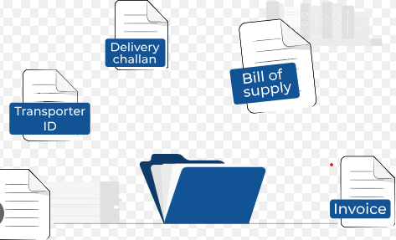
FAQ
Can two E-way bills be generated for a particular invoice or delivery challan?

Slide 13

FAQ
What is the relevance of entering pin codes while generating E-Way Bill?

Slide 14

FAQ
Can seizure order be passed if the e-way bill produced after the inception but before the order passed?
Detention of goods and vehicle
E-Way Bill produced
Order in FORM GST MOV - 06

Slide 15
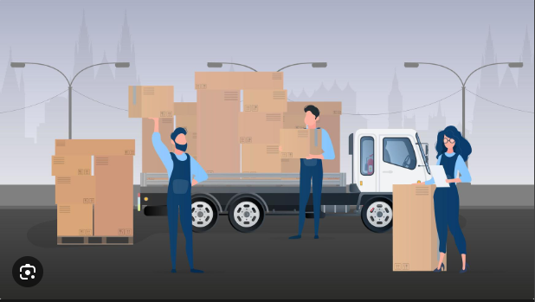
FAQ
Consequences of taking goods to a different location provided there was no procedure lapse?

Slide 16
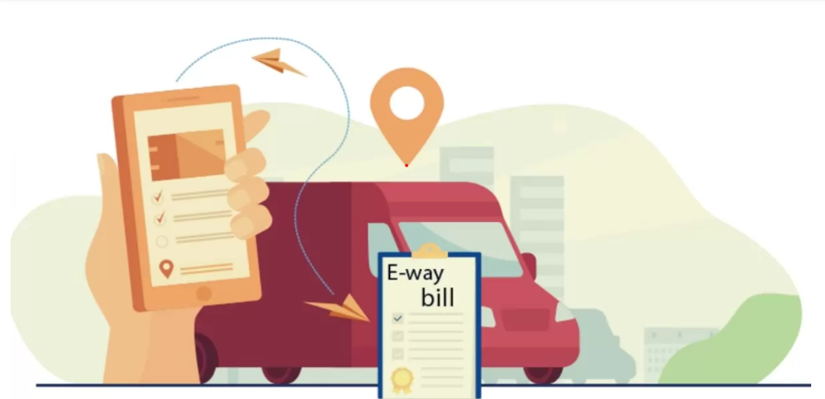
FAQ
Consequences of minor difference between the address shown in Invoice and shown in e-way bill
Reference: M.R Traders V. Asstt. State Tax Officer [2020 (80) GST 287 (Kerala)]

Slide 17


FAQ
What will happen if instead of IGST is charged instead of SGST and CGST or vice-versa?
INTRA-STATE
INTER-STATE
IGST
CGST + IGST

Slide 18

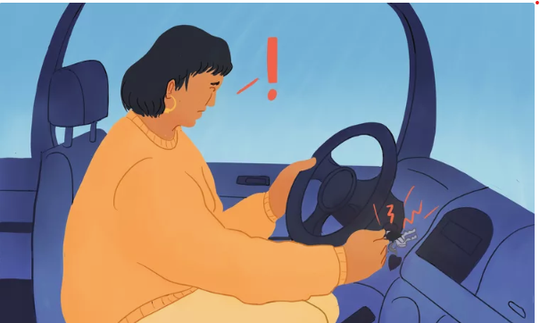
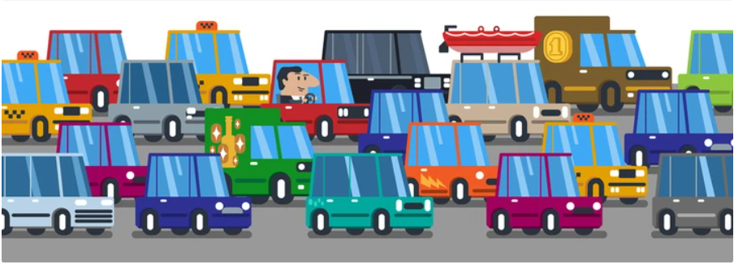
FAQ
Consequence of delay in delivery due to some uncontrollable and unforeseeable circumstances?
Reference: Assistant Commissioner (ST) v. Satyam Shivam Papers (P.) Ltd. [ 2022 (57) GSTL 97/ 90 479 (SC)]

Slide 19
FAQ
Consequences of entering wrong vehicle number on the e-way bill?
Reference: Varun Beverages Ltd. v. State of U.P. [2023 (71) GSTL 4/ 96 GST 587 (Allahabad)]

Slide 20

FAQ
Goods detained citing reasons like
Purchasing firm or vendor of consignee is non-existent or
References: Shiv Scrap Sales v. State of U.P. [2023 (70) GSTL 456 (Allahabad)
Goods are being brought from some other location and not from the address mentioned in the documents
References: S.R. sales v. State of U.P. [2023 (71) GSTL 364 (Allahabad)]
Driver does not possess the Invoice (check whether E-Invoice made)
References: Shameer Chingaman Poyil v. ASTO [(2020) 114 taxmann.com 475 (Ker.)]
Minor Invoice issues like GSTIN not clearly mentioned or Invoice no not serially maintained
References: Premium Traders v. State of U.P [2022 (64) GSTL 436 (All.)]
Devices Distributors v. ASTO [(2020) 118 taxmann.com 136 (Ker.]

Slide 21
SOME UNFAVOURABLE JUDGMENTS
6. Applicability of Limitation Act, 1963 on CIRP Proceedings
Sonali Metal Industries LLP
vs.
State Tax Officer (Intelligence)
[2022] 94 GST 947 (Madras)
  It was claimed that goods originated from Guwahati, but toll booth records did not show any movement of the vehicle in that sector.
  On the basis of the records of toll taxes, the department suspected that the goods actually originated from Telangana and not Guwahati and a notice proposing a penalty was issued.
  The Court held that the petitioner could have provided toll receipts or other evidence to disprove the suspicion. Since this would involve examining disputed facts, the writ petition was dismissed, as the petitioner had an alternate remedy to approach the Appellate Authority
Ashok and Sons (HUF)
vs.
Jt. Commissioner, State Tax [2023]
72 GSTL 15 (Cal.)
  Vehicle broke down on the route and could not reach the destination within the time limit specified in the way bill.
  Vehicle detained because the e-way bill had expired and penalty was imposed.
  It was argued by the petitioner that tax was already paid and there was no intent to evade tax. It was also argued that the originating state's tax authority had no jurisdiction for inter-state supplies as GST is a destination based tax.
  The Court held that the authority was legally allowed to impose the penalty under the provisions of the Sec. 129 of the Act.

Slide 22
SOME UNFAVOURABLE JUDGMENTS
6. Applicability of Limitation Act, 1963 on CIRP Proceedings
New Royal Ferrous and Non-Ferrous Trading Corporation
vs.
Dy. State Tax Officer,
[2023] 97 GST 487 (Madras)
  The e-way bill was generated 9:56 p.m. and the vehicle was spotted at approx. 150 kms away from the orgin within 1 hour.
  Question was raised as to how could a vehicle reach 150 kms in an hour of generation fo e-way bill.
  The court held that the determination of this question relies on factual evidence and, therefore, the court would not interfere with the notice issued.
  The petitioner was instructed to respond to the notice, and the respondent would consider their response after providing an opportunity to the petitioner.
Shrimali Industries (P.) Ltd.
vs.
State of Rajasthan, [2022]
[2023] 69 GSTL 47 (Rajasthan)
  The description of the goods being transported in the documents differed from the actual goods transported.
  It was alleged that the petitioner was attempting to evade the differential taxes.
  The court upheld the detention of the mis-declared goods, ruling that the writ petition was not maintainable.

Slide 23
Tips for smooth compliance
The description code of the goods being loaded into the truck is accurate and complies with the information provided in the invoice.
Please verify whether the place of business where the goods are meant to be delivered is the actual delivery location, especially if the recipient has other places of business apart from their usual place of business.
Make sure that all your business locations, such as depots, sales offices, factories, and sectors, are properly listed as additional places of business in your GST registration. It's crucial to ensure that these locations are accurately mentioned as the places of dispatch as well.
To ensure smooth communication, kindly instruct the driver to promptly notify you if any unavoidable circumstances, such as vehicle problems or anything else causing, arise on the way, at least eight hours before the E-way bill expires.
In the event that the driver is unable to inform you within the specified timeframe, please make sure to send a comprehensive report, including all relevant documents, to our registration office. Mention in the report that the E-way bill extension was not feasible due to the expiration of the 8-hour window, resulting in a delayed delivery of the goods due to unforeseen circumstances. Provide all the relevant facts of the case, including details about the vehicle and any other pertinent factors contributing to the delay.
Maintain records of all challans, toll tax receipts, and relevant documents to substantiate a transportation in any future legal proceedings. Complete documentation will provide evidence and support your case, preparing you for any potential legal matters.

Slide 24
THANK YOU

Slide 25
OTHERS – NOT FOR REFERENCE

Slide 26
Legal Framework

Slide 27
Important Points of E-Way Bill
No E-way Bill can be edited or amended - It can be cancelled within 24 Hrs if required and generate new.
Transportation (Vehicle) details can be updated any no. of times till the goods reaches the destination within the validity period.
Validity of the E-way Bill starts from the time of first entry of Part-B (Vehicle Details), not from the time of generation of e-way bill
E-way bill generated is invalid for movements of goods, if it is not updated with the Part-B, if the travel distance is more than 10 Kms.
Part-B updating is not must for first and last mile of travel, if the distance is less than 10 kms.
Consolidated E-way bill does not have any specific validity. It depends upon the e-way bills attached to it.
For one E-way bill multiple modes of transportation can be updated – Like first Ship, then Air and Road.

Slide 28
Every registered person who causes the movement of goods of consignment value exceeding Rs.50,000
Case | Total | E-Way bill Requirement
Item Price = 50000 Tax = 1000 | 51000 | Yes
Item Price = 48000 Tax = 1000 Items Specified in Annexure to Rule 138 = 2000 Tax = 0 | 51000 | No
Item Price = 48000 Tax = 1000 Non GST = 2000 Tax = 0 | 51000 | Yes
Item Price = 48000 Tax = 1000 (Goods sent to Job worker) | 49000 | Yes

